Slide 1
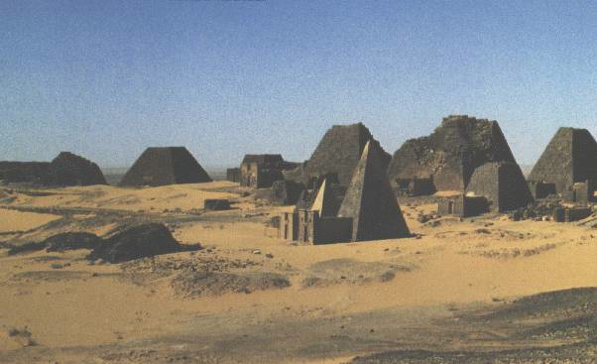
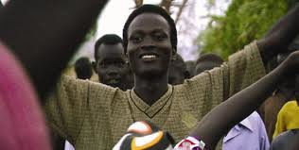
Contemporary Sudanese Literature

Slide 2
Please answer the following questions about the What is the What excerpt in your notes:
Who knocks on Valentino’s door? What do they want?
Where are Kakuma and Pinyudo? What were Valentino’s experiences there?
Where does Valentino live and what is his job? Is he satisfied with it?

Slide 3
“I am tired of this country. I am thankful for it, yes, I have cherished many aspects of it for the three years I have been here, but I am tired of the promises. I came here, four thousand of us came here, contemplating and expecting quiet. Peace and college and safety. We expected a land without war and, I suppose, a land without misery. We were giddy and impatient. We wanted it all immediately-homes, families, college, the ability to send money home, advanced degrees, and finally some influence. But for most of us, the slowness of our transition-after five years I still do not have the necessary credits to apply to a four-year college-has wrought chaos. We waited ten years at Kakuma and I suppose we did not want to start over here. We wanted the next step, and quickly.

Slide 4
But this has not happened, not in most cases, and in the interim, we have found ways to spend the time. I have held too many menial jobs, and currently work at the front desk of a health club, on the earliest possible shift, checking in members and explaining the club's benefits to prospective members. This is not glamorous, but it represents a level of stability unknown to some. Too many have fallen, too many feel they have failed. The pressures upon us, the promises we cannot keep with ourselves-these things are making monsters of too many of us” (page 4 paragraph 1).

Slide 5
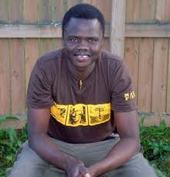
What is the What: The Autobiography of Valentino Achak Deng
Born in S. Sudanese village of Marial Bai
1987: fled with the 20,000 Lost Boys to refugee camps in Ethiopia and Kenya
Resettled in Atlanta
by US gov and
Christian charity
✪ Collaborated with Dave Eggers to tell his
story in What is the What (2006)
✪ All proceeds go to Valentino Achek Deng Foundation

Slide 6
What is the What Analysis
In your letter groups, read and analyze the passages by completing the chart on the reverse side
Groups A-C: Valentino’s impressions of the robbers and the robbers’ impressions of Valentino
Groups D-G: Valentino’s experiences of robbery, betrayal, violence, and friendship in Africa and America
*Pay attention to number roles*

