Slide 1
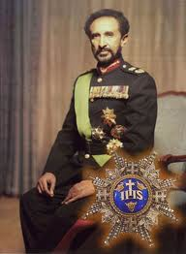
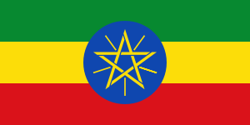
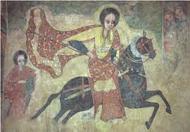
From Aksum to Ethiopia

Slide 2
Take out The Guardian article and the 3 homework questions and discuss your answers with a partner (1s and 3s, 2s and 4s)
What is the history of the relationship between Italy and Ethiopia?
What is the meaning and significance of the term Italiana brava gente? What contradictions does Maaza Mengiste bring to light about this stereotype?
How does Mengiste describe Italy confrontation with their past relations with Ethiopia? How are Italy and the Italian people dealing with this history?

Slide 3
Maaza Mengiste
Ethiopian-American writer, documentarian, and human rights activist
Born in Addis Ababa, Ethiopia
Lived in Nigeria, Kenya and the US
Beneath the Lion’s Gaze (2010): award winning novel about Ethiopia in the 1970s and the controversy surrounding the death of Haile Selassie

Slide 4
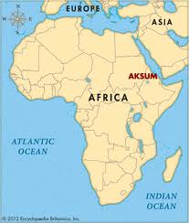
Kingdom of Aksum (1st-7th Centuries)
Northern Ethiopia and Eritrea

Slide 5
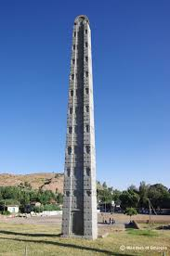
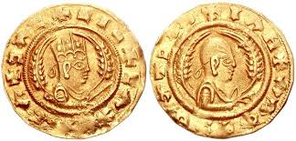
Kingdom of Aksum
Natural resources: timber, water sources, fertile soil, pastures (cattle), grains (teff)
Social Structure: Hierarchical – King (ex: Ezana, c.321-360), nobles, priests, traders, craftsmen, farmers
Cities: Aksum (capital), Adulis (trade city)
Trade: South Arabia and Roman Empire
Religion: Indigenous religion ➔Judaism, Christianity, Islam

Slide 6
The Kingdom of Aksum in the British Museum
In your letter groups:
Analyze the Aksum artifacts and read the accompanying descriptions provided by the British Museum
On a separate piece of paper, answer the questions or complete the tasks related to your groups assigned aspect of the Kingdom of Aksum (trade, religion, monarchy, or domestic life)

