Slide 1
The Renaissance

Slide 2
Review the definition of “Humanism” and answer the following question in your notes:
Humanism: An intellectual movement focused on human potential and achievement.
What does a humanist education system look like? Is our American education system humanistic?
Notes:
The reason I wanted to start with this question today is because a society’s education system reflects their values and ideals. At its core, the purpose of an education system is to groom children in a society to become ideal functioning adult members of society. Later on in class we will be exploring the effects of humanism on the education system of the Renaissance, and explore whether or not our education system is still effected by this movement.

Slide 3
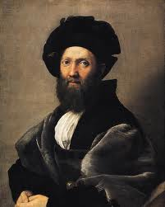
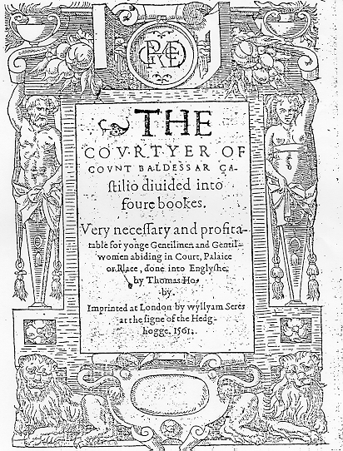
Renaissance Man and Woman (sort of)
Re-popularized classical education: history, literature, philosophy, rhetoric, geometry
“Universal Man” ➔ “Renaissance Man”: a man who excels in all areas
The Book of the Courtier (1528), Baldassare Castiglione: taught how to become a Renaissance Man/Woman
Notes:
Speaking of learning – Humanism and the renewed focus on the individual revived the focus on a classical Greek education (the Byzantines also attempted to model their education off of the Greek classic, we looked at it in class)
Painting of Castiglione by Raphael

Slide 4
The Book of the Courtier
In your letter groups…..
Read your assigned passage from The Book of the Courtier on the “Universal Man.”
In your notes, record the areas of study your passage indicates the courtier must excel. Why does Castiglione say this area is important to master?
Share your answers to part 2 with your group
Read the passage from The Book of the Courtier on the “Universal Woman.”
In your notes, record Castiglione’s expectation for women. How do they differ from his expectations for male courtiers? According to Castiglione, what is the “nature” of women?

Slide 5
The Renaissance Man
Renaissance Period
Modern Day
Latin and Greek
Reading/writing poetry and prose
Orator
Historian
Tennis
Dancing
Music
Painting
Weaponry
Foreign Language
English class
Politics/speech and debate
History class
Gym/sports
Socializing/being attractive to the opposite sex
Art class
Being tough

Slide 6
Final Question: In today’s world, is it better to be a “Renaissance Man/Woman” or to specialize and become an expert in a single area? (2-3 sentences in your notes) Discuss in your “letter groups”

