Slide 1
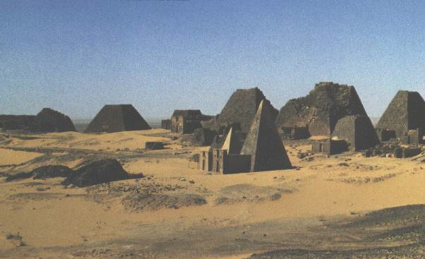
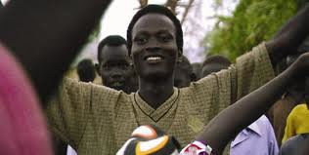
Sudan

Slide 2
Answer the following question in your notes:
Imagine you are coming to America for the first time and have no knowledge of American society - what aspects of American culture would surprise or confuse you most? Why?

Slide 3
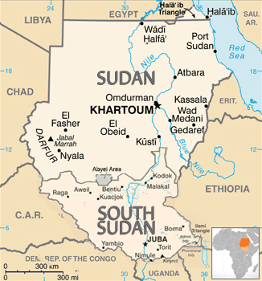
Sudan

Slide 4
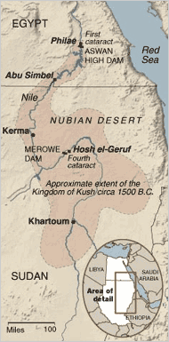
Kingdom of Kush (8th century BC-4th century AD)
Formed along Blue and White Nile Rivers
Strengthened after the New Kingdom of Egypt
Capital: Kerma ➔Meroe
1st in the world to use iron smelting technology

Slide 5
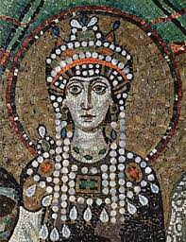
Christianity and Islam
540 AD: Christian missionaries sent by Empress Theodora
7th century: transition to majority Islam through Arab conquests
1093: 1st Arab/Nubian native Muslim prince
16th century: Ottoman Empire
1890s: Joint British and Egyptian rule
1956: Sudanese independence

Slide 6
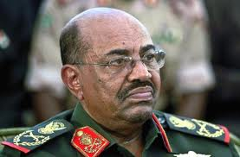
1983-Present
1983-2005: 2nd Sudanese Civil War – Islamic north vs. Christian and Anamist south (Dinka)
Janjaweed: Islamic military rebel group - genocide against Christians and Animists
1989: Omar al-Bashir ➔military coup – Islamic legal code, persecuted political opponents
Estimated 2 million perished
2011: South Sudan independence

Slide 7
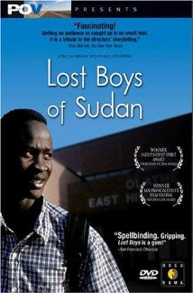
The Lost Boys of Sudan
Lost Boys of Sudan: 20,000 boys of Nuer and Dinka ethnic groups displaced and orphaned by Second Sudanese Civil War
Fled on foot from southern Sudan ➔Ethiopia ➔Kenya
Since 2001, 3,000 airlifted to the US
Documentary: Lost Boys of Sudan (2003) – 2 Dinka boys’ (Peter and Santino) journey from Kenyan refugee camps to the US

Slide 8
What is the What (2006) Dave Eggars and Valentino Achak Deng

