Slide 1
Central and Eastern Africa:
Cultural History and Modern Voices

Slide 2
In your letter groups: Put the following continents in order from largest to smallest (area)
Europe
Australia
North America
South America
Africa
Antarctica
Asia

Slide 3
In your letter groups: Put the following continents in order from most to least populous
Europe
Australia
North America
South America
Africa
Antarctica
Asia

Slide 4
The continents in order from largest to smallest
Asia – 16,920,000 mi^2
Africa – 11,730,000 mi^2
North America – 9,460,00 mi^2
South America – 6,890,000 mi^2
Antarctica – 5,300,000 mi^2
Europe – 3,930,000 mi^2
Australia – 3,478,200 mi^2

Slide 5
The continents in order from most to least populous
Asia – 4,164,252,000
Africa – 1,022,234,000
Europe – 738,199,000
North America – 542,056,000
South America – 392,555,000
Australia – 29,127,000
Antarctica – 4,490

Slide 6
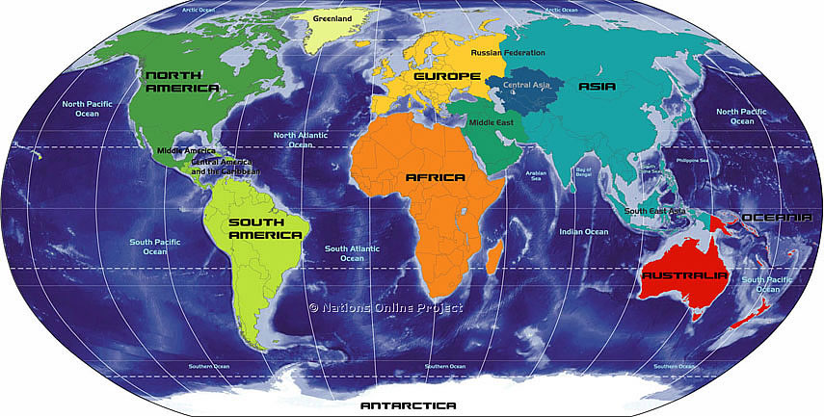

Slide 7
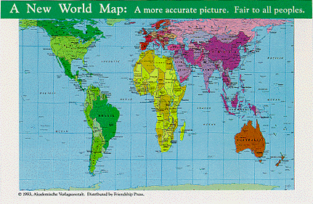

Slide 8
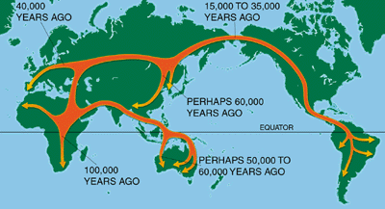

Slide 9
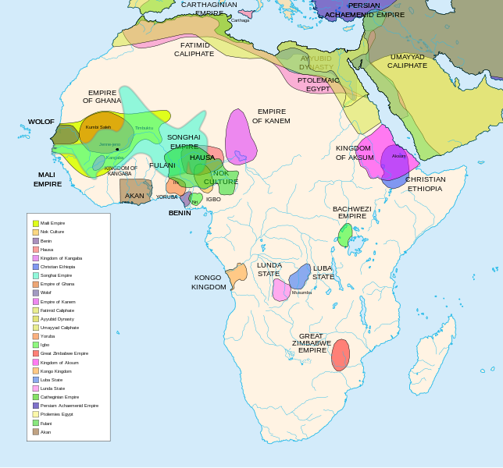

Slide 10
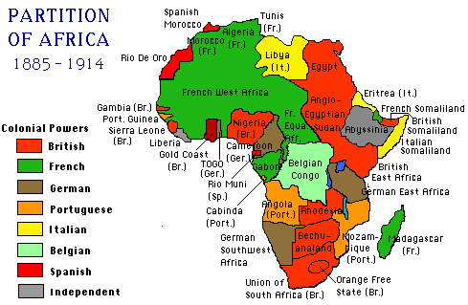

Slide 11
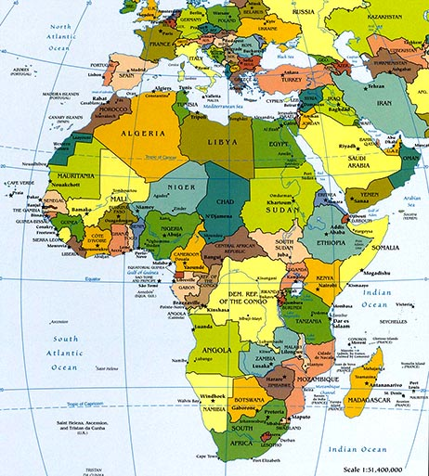

Slide 12
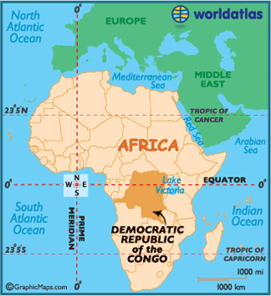
Efé People

Slide 13
Draw this table in your notes
Artifact | Description | Use | Societal Significance
A
B
C
D
E

Slide 14
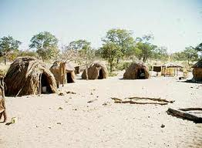
Object C

Slide 15
Efé People
Hunter-gatherers in Ituri Forest (Democratic Republic of the Congo)
Ethnic group: “Pygmy” – short stature – genetically oldest human race
Live in small groups (10-100) of related individuals
Semi-nomadic: temporary grass and brush huts

Slide 16
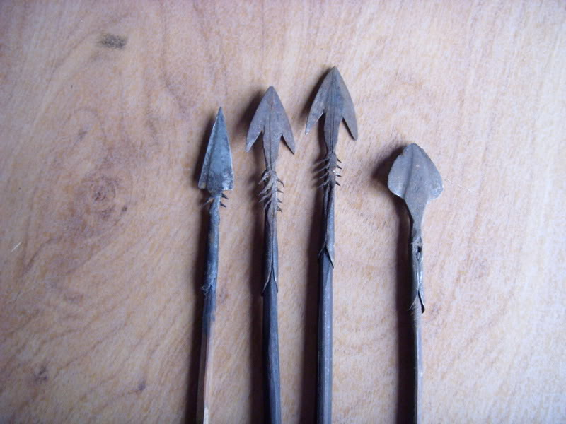
Object A
Object B

Slide 17
Food Supply and Economy
Women = gatherers: roots, yams, nuts, seeds, mushrooms, timber, water
Men = hunters: antelope, monkeys, catfish
Trade: wild game, crops
Poison-tipped arrows
Semliki Harpoon

Slide 18
Social Structure and Culture
Patrilineal society
Leader: older male – does not act as chief
Decision making through long discussions
No written laws
Cooperative childcare
Language: shared with Lese people, linguistic roots in southern Sudan
Religion: not recorded – creation myths, legends of origin, traditions, human and supernatural social relations

Slide 19
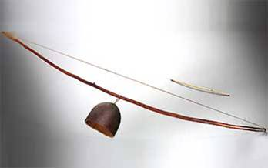
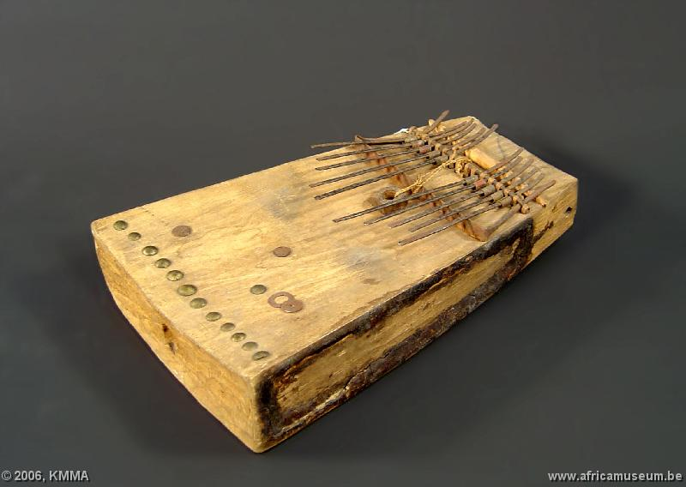
Object D
Object E

Slide 20
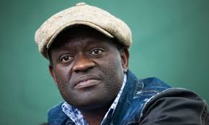
Alain Mabanckou
Born 1966 in Democratic Republic of the Congo
Poet, novelist, journalist, and academic
Studied in France
One of most successful Franophone authors
2006-presesnt: UCLA professor
Tomorrow I’ll Be Twenty (2013)

